Slide 1
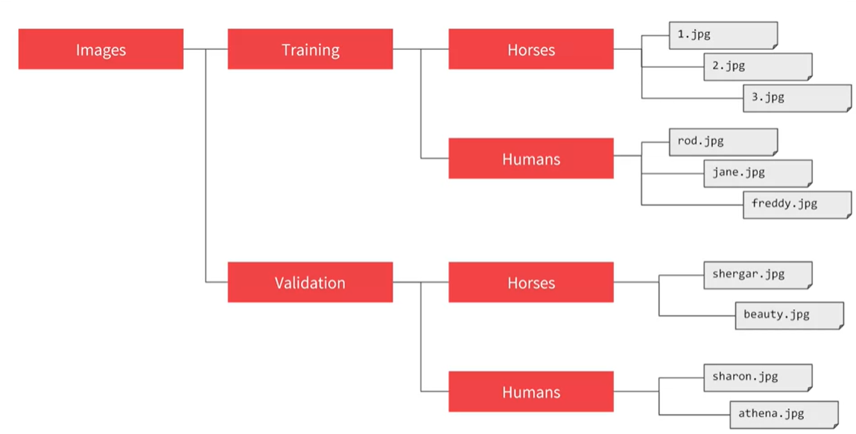

Slide 2
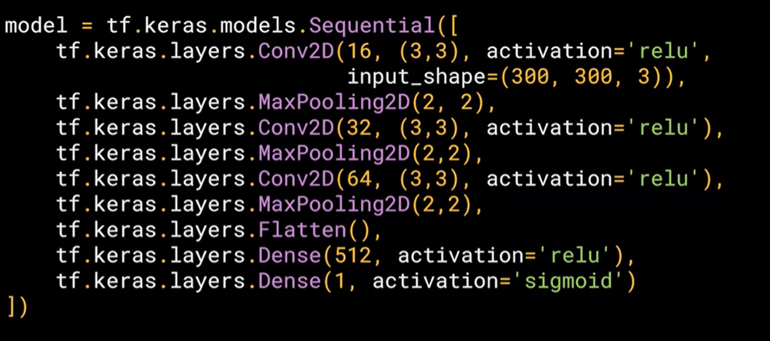

Slide 3
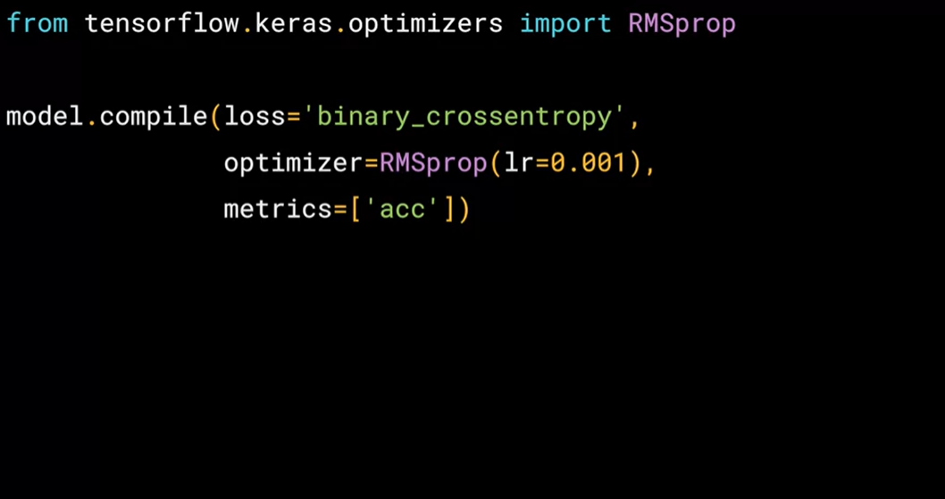

Slide 4
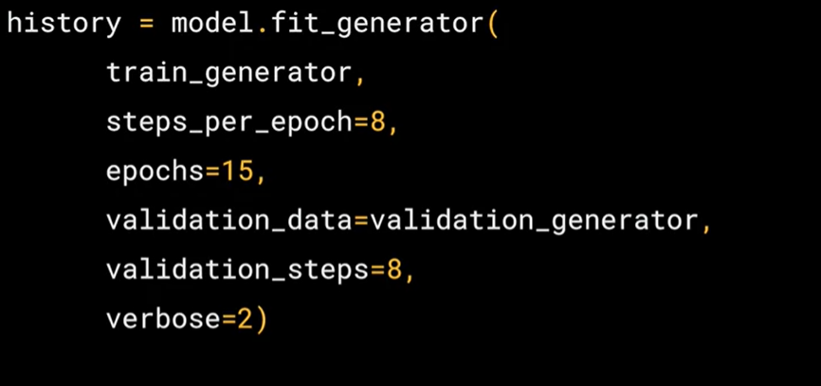

Slide 5
https://ml-cheatsheet.readthedocs.io/en/latest/optimizers.html#adam
https://gombru.github.io/2018/05/23/cross_entropy_loss/
https://www.youtube.com/watch?v=eqEc66RFY0I
https://www.youtube.com/watch?v=sDv4f4s2SB8
https://www.youtube.com/watch?v=yFPLyDwVifc

